Slide 1
Diving Deeper into Deprivation within New Zealand
Cadence Liu and Josh Atwal
Notes:
Kia ora koutou katoa Good afternoon everyone. Today me and my partner are here to give a talk about our project - A deeper dive into Deprivation within New Zealand.
Before we get into the contents, please allow us to introduce ourselves.
Ease up on acronyms
States slide 5 still not my favourite, feels like its targeting Maori now lol
maori greeting tena koutou or even home language
beginning of presentation, second slide to intro team, intro yourself
problem statement before map as it is too confronting - lead to how purple things correlate with index
engage with them and show what we found interesting and fun
let them know what we have learnt doing this project
after datazones shown and talked about idi, for 10 second ‘im assuming everyone knows what idi is and datazones are’ for those that dont have a look at stats nz because the concept and detail is overwhelming

Slide 2


Cadence Liu
Josh Atwal
MDataSci
Background: CompSci
MDataSci
Background: Statistics
Notes:
My name is Cadence, i’m currently studying the first year of my Data Science Masters, and I come from a background of Computer science.
-josh intro-

Slide 3
CONTENTS
01.
02.
INTRODUCTION
DATA
03.
04.
SOLUTION
CONCLUSION
What is ‘Deprivation’ and why it matters
What kind of data is available?
A demonstration of our solution.
Limitations and real-world applicability
Notes:
Here’s a summary of what you can expect from our talk today, i’ll be covering the first half - an introduction to deprivation and why it matters, and a little bit on the data side of things before passing it over to Josh who will cover the technical details of our solution as well as some applications and limitations.

Slide 4
01.
INTRODUCTION
What is ‘Deprivation’ and why it matters
Notes:
First i’d like to set the scene by talking a little bit about deprivation and why it matters

Slide 5
“The Single Biggest Issue”
More than 60%
7 Years
Facing the country since 2014 according to polling of New Zealanders
of decile 10 population are young Māori under the age of 25
The difference in life expectancy between Maori and non-Maori
Notes:
a poll conducted in 2014 ranked deprivation as the single biggest issue in new zealand, and that more than 60% of decile 10 population are young maori under the age of 25
a direct result of this is shown in the life expectancy of maori and non-maori - a difference of 7 years - which is really about 10 percent of a person’s lifetime. not ideal to say the least
as we all know, lot of effort has already gone towards reducing inequality in NZ
this is mainly done by addressing different kinds of deprivation across different communities.
https://berl.co.nz/our-pro-bono/inequality-and-new-zealand
https://library.oapen.org/bitstream/id/772ac1fe-6178-4d9c-b27e-89a02dafb66f/637854.pdf
Ref: https://www.inequality.org.nz/understand/
https://www.stuff.co.nz/stuff-nation/126416378/our-housing-situation-is-driving-inequality-and-its-dangerous
https://www.stuff.co.nz/national/politics/126512059/mori-will-take-a-century-to-catch-up-with-pkeh-for-life-expectancy-new-report-finds

Slide 6
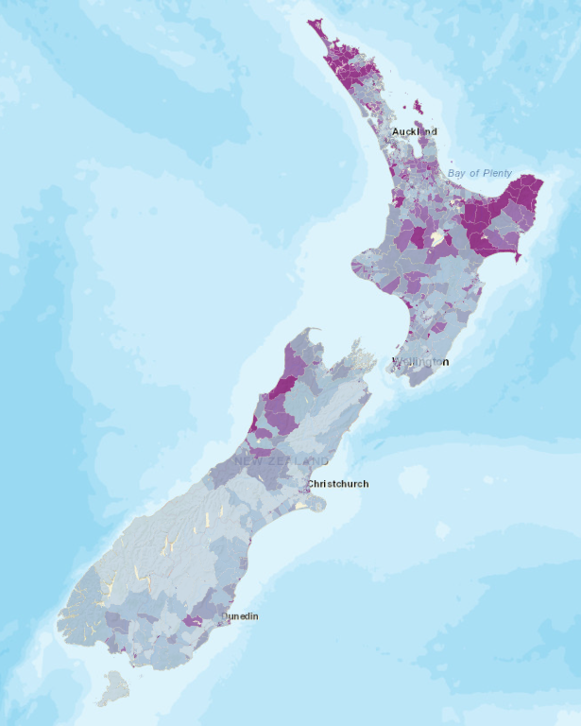
Index of Multiple Deprivation (IMD18)
Visualises relative deprivation
Drives decision making
Access
Crime
Education
Employment
Health
Housing
Income
Notes:
One of the most prominent tools used for understanding deprivation in NZ is the Index of Multiple Deprivation - created by researchers from our university.
its main use is to visualise the relative deprivation between different areas in new zealand
visualized on the map is an overall measure of how deprived a region is, the darker an area is, the more deprived
it has Range of uses from supporting community advocacy to driving resource allocation and policy making
the main benefit of this tool is that instead of just a singular decile number, an area is ranked on 7 different domains of deprivation
access to facilities, crime rates, quality of education, level of employment, health outcomes, housing availability, and finally level of income.

Slide 7
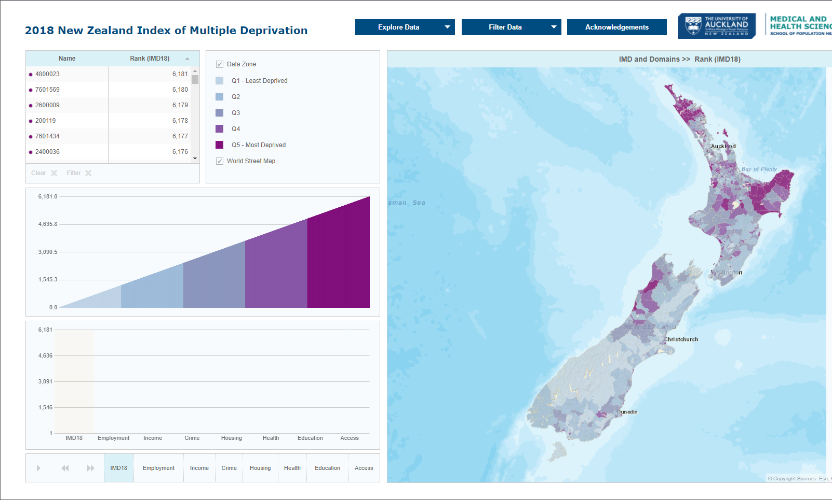
IMD18 Online
What is driving the deprivation?
External regional reports
Reports are not user-friendly
Notes:
Though it’s more descriptive than just a singular decile number, the tool still struggles to answer some truly important questions - what’s actually driving the deprivation?
In order to answer this question currently, users have to submit a request to generate a 20-page report, and flick through the whole thing to find the one bit of information they are after.
this information is usually provided in a highly statistical manner, making the entire experience very much user-unfriendly

Slide 8

Project Motivation
Dr Daniel Exeter - UoA FHMS
Main author behind IMD18
His clients had the following concerns:
Notes:
This is why we have been put in contact with dr daniel exeter, which is the main author behind IMD18.
His client had the following concerns:

Slide 9
“I have been newly assigned to a DHB and want to understand which areas are deprived and why. This will be used to drive allocation of DHB resources and services”
Notes:
A decision-maker high up at the DHB has been recently transferred to a new region , and they’re finding that the new population have different habits, age distributions and thus different needs.
This means that though they have a lot of domain knowledge, it doesn’t directly transfer to the new population, and they’re looking towards IMD18 to assist with this transition.
in order to distribute the DHB’s resources and services to the people that need it the most, what’s first required is a holistic understanding of deprivation in the new region.
the cause and effects that they have so accustomed to is not so valid
This means that their domain knowledge is not fully transferable, and they are looking to IMD18 to get a quick and very visual understanding of the new region in order better allocate resources and services

Slide 10
Understanding Deprivation
Types of crimes being committed?
Income/Ethnicity breakdown?
Correlation between health and Fast food/Alcohol outlets?
Comparison with Regional/National averages?
The IMD18 App is currently not equipped to answer these questions.
Notes:
At the initial consultation, the client expressed their needs to have the following questions answered:
when we say crime is high in an area, what types of crimes are being committed, is there an income level breakdown, or an ethnicity distribution in the area?
and is there a correlation between heath and fast food or alcohol outlets?
All of the above needs to be compared with regional and national averages in order to make meaningful inferences.
Unfortunately the IMD18 app is just currently not equipped to answer these questions.

Slide 11
Problem Statement
Improve the usability of IMD by creating a new interactive platform that allows for deeper exploration in a user-friendly manner
Notes:
After we have a full grasp over the use case, we decided to generalize the issue to the following problem statement:
to improve the usability of IMD by creating a new interactive platform that allows for deeper exploration in a user-friendly manner.

Slide 12
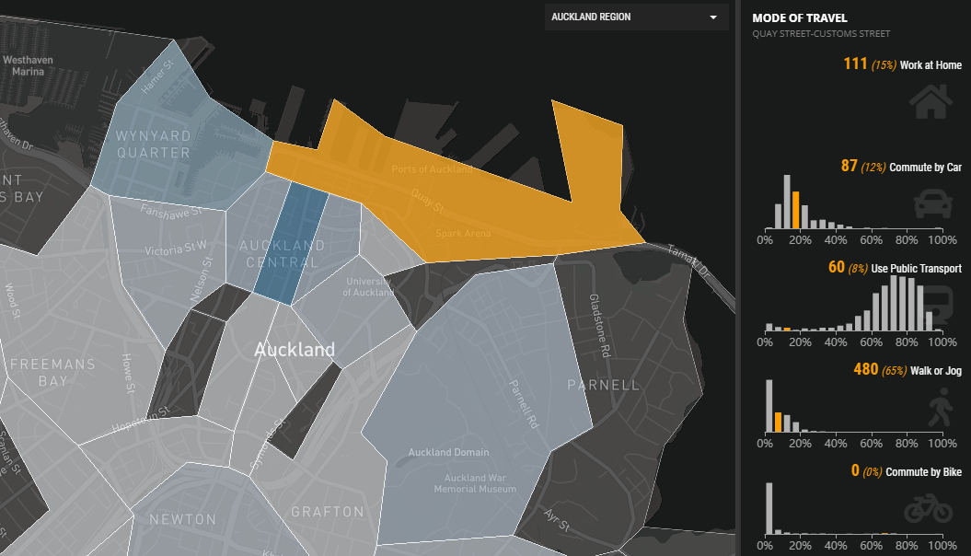
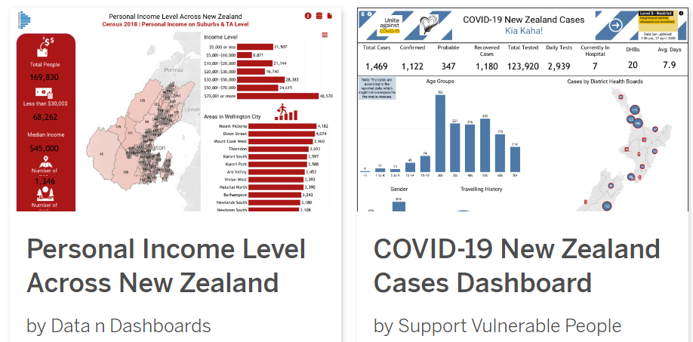
Potential Solutions
IMD18 - Off-the-shelf solution
Shortlisted:
R Shiny vs Tableau
Tableau:
Modern & visually appealing
Geospatial Integration
Widely used in business and govt
IMD refresh - Caters towards non-statistician’s future work
R Shiny
Tableau
Notes:
IMD18 app is an off-the-shelf solution and lacked the customizability we needed.
We investigated a range of possible solutions and shortlisted R Shiny and Tableau, opting for the more adventurous choice with Tableau in the end.
We knew R Shiny would be a crowd favourite from the stats department, but it was Dr Exeter who actually encouraged us as new blood to bring some fresh ideas to the table by exploring what’s new and exciting out there, so that was a big influence on why we chose Tableau instead of the tried and trusted R Shiny.
We found that both options were about equally powerful, but tableau had a modern and visually appealing look, and excellent geospatial integration, which was exactly what we were after. Since it's already widely adopted in business and government, it also made a lot of sense for us to give it a chance in a research perspective to see what it truly has to offer.
Additionally The IMD is an ongoing project, and there WILL be data refreshes in the future, in which case non-statisticians would be able to use tableau a lot more effectively compared to R shiny as an additional benefit.
perhaps someone from dan’s team needs to integrate a new source of data, in which case even a non-statistician could easily implement new visualizations without relying on the stats department.
Both offer the same kind of features, however we found tableau to be the choice that made more sense.
It has a low start-up cost, a wide range of appealing visualizations (including geospatial ones) and is also broadly used in both business and public health context in NZ already.
The user-friendliness and accessibility of tableau also meant that further development by the client would be fairly straightforward
https://nz-stefan.shinyapps.io/commute-explorer-2/
https://public.tableau.com/en-gb/search/all/%23NZ

Slide 13
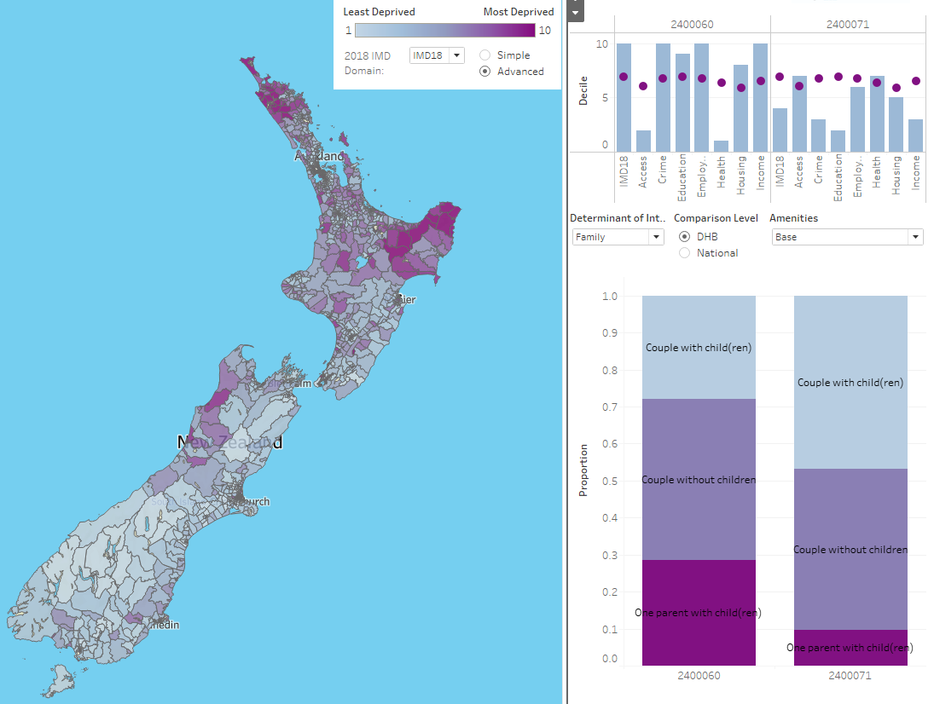
Solution Outline
Recreate existing IMD18 app
Determine feature priority
Investigate what is possible
Gather new data
Implement new visualisations
Notes:
With all that said, we defined our 5 key steps as follows
Firstly, to recreate the existing IMD18 app in tableau,
then decide what kind of information we want to display
Investigate what’s possible,
gather the new data
and implement the new visualizations

Slide 14
02.
DATA
Notes:
That’s all for the introduction, next i’ll be covering a little more on the data side of things.

Slide 15
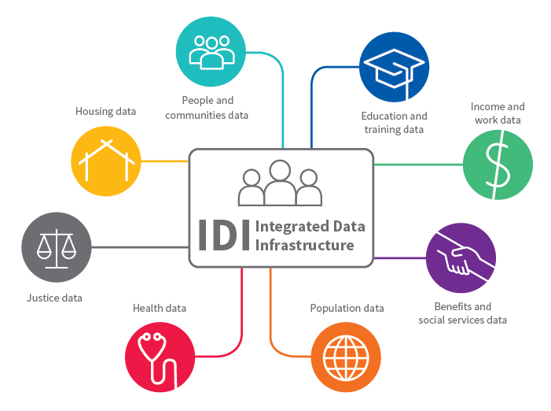
Data Source
Private data:
IDI - Integrated Data Infrastructure
Public data:
IMD18 - Ranking for each deprivation domain
STATS NZ - Census data
NZ Police - Crime data
OpenStreetMaps - Locations of interest
Notes:
with the datasource we identified 5 main sources of data, in NZ there is the integrated data infrastructure which is basically the central source of truth for a lot of governmental and NGO statistics, so you can see there's housing, health, and income data, and it's all centrally linked and aggregated into one place.
This would be our most truthful source of data, and we decided to complement that with a variety of public data
from the IMD18 is the ranking for each deprivation domain, which is what we’ve already seen in the existing visualization
From the STATS NZ website we were able to access census data,
from the nz police website we were able to download crime data
and lastly, we used openstreetmaps to determine the locations of interest - like fast food and alcohol outlets

Slide 16
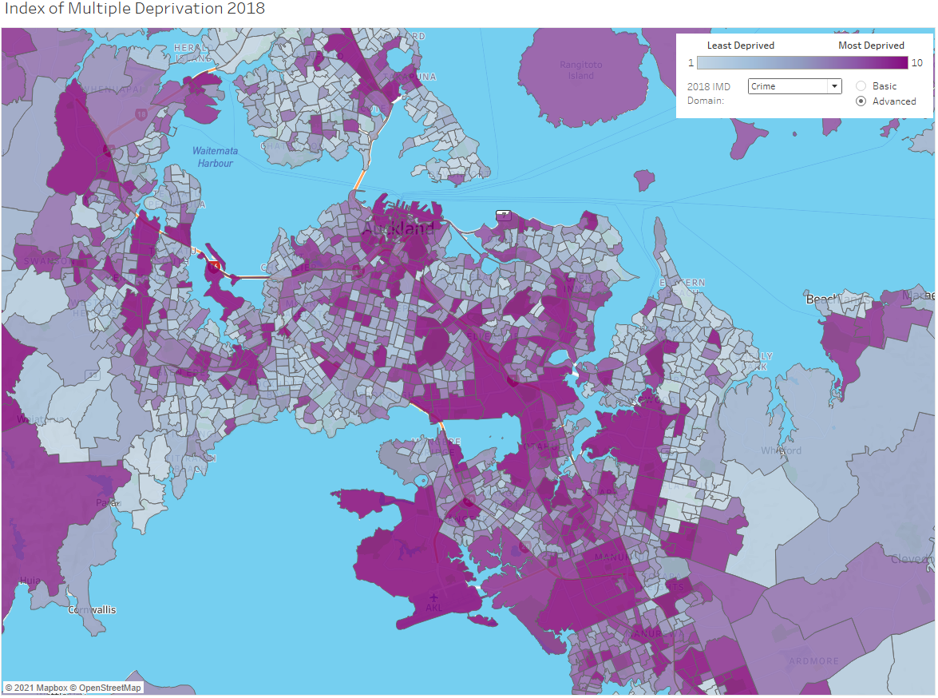
Datazones
Primary unit of population
~6,000 datazones
~700 residents in each
Notes:
The IMD18 breaks new zealand down into about 6000 “datazones“ with roughly 700 residents in each.
This was our primary unit of population, but unfortunately not every data source was available at this resolution so the Bulk of our preprocessing work was to aggregate the data to the correct granularity

Slide 17
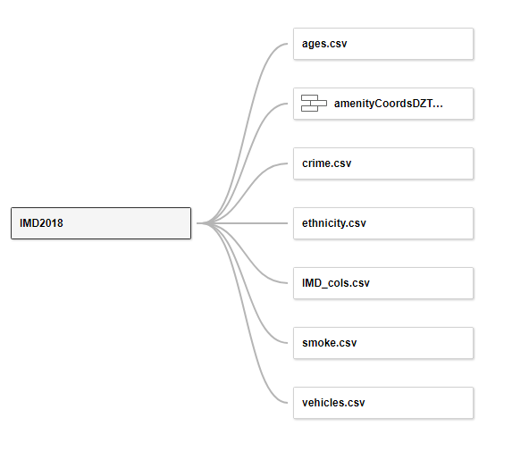
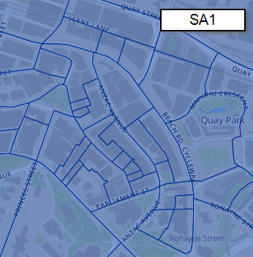
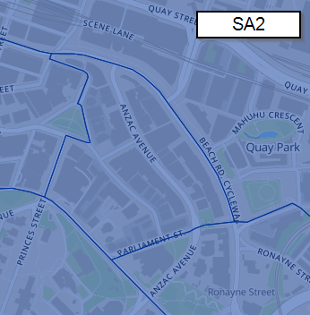
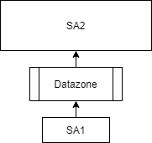
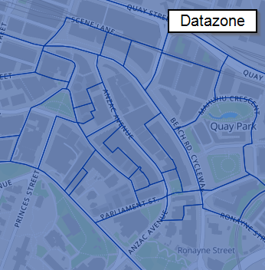
Data Preprocessing
Statistical Area 1 & 2 (SA1 & SA2)
Notes:
the statistical area standard splits new zealand at different granularity levels - over on the right you can see that at the broadest level is the SA2, we can then see a perfect split into the datazone level, and again into SA1 level.
A big part of data preprocessing was getting the data to the datazone level
When we encountered data at a broader level, we had to break those numbers down by finding the datazone population distribution and scaling the numbers accordingly.
Conversely, when we encountered data in the more granular sa1 level, we had to aggregate the data to represent the correct datazones.
To get all of the data to the datazone resolution we had to create mappings between datazones and some of the other population units used in new zealand
For example for data at the statistical area 2 level which was bigger than datazone, we downsampled using the relative population sizes of the datazones within the SA2
All datasets could then use the common Datazone column to be joined together
https://www.stats.govt.nz/methods/statistical-standard-for-meshblock

Slide 18
Data Preprocessing
Statistical Area 1 & 2 (SA1 & SA2)
Notes:
in new zealand there exists the statistical area standard which splits new zealand at different granularity levels - over on the right you can see that at the broadest level is the SA2, we can then see a perfectly split of SA2 into the datazone level, and datazones even further into SA1 level.
A big part of data preprocessing was getting the data to the datazone level to join onto the IMD data.
When we encountered data at a broader level, we had to break those numbers down by finding the population distribution of all datazones within the SA2 and scaling the numbers accordingly.
Conversely, when we encountered data in the more granular sa1 level, we had to aggregate the data to represent the correct datazones.
To get all of the data to the datazone resolution we had to create mappings between datazones and some of the other population units used in new zealand
For example for data at the statistical area 2 level which was bigger than datazone, we downsampled using the relative population sizes of the datazones within the SA2
All datasets could then use the common Datazone column to be joined together
https://www.stats.govt.nz/methods/statistical-standard-for-meshblock

Slide 19
Data Preprocessing
Statistical Area 1 & 2 (SA1 & SA2)
Notes:
in new zealand there exists the statistical area standard which splits new zealand at different granularity levels - over on the right you can see that at the broadest level is the SA2, we can then see a perfectly split of SA2 into the datazone level, and datazones even further into SA1 level.
A big part of data preprocessing was getting the data to the datazone level to join onto the IMD data.
When we encountered data at a broader level, we had to break those numbers down by finding the population distribution of all datazones within the SA2 and scaling the numbers accordingly.
Conversely, when we encountered data in the more granular sa1 level, we had to aggregate the data to represent the correct datazones.
To get all of the data to the datazone resolution we had to create mappings between datazones and some of the other population units used in new zealand
For example for data at the statistical area 2 level which was bigger than datazone, we downsampled using the relative population sizes of the datazones within the SA2
All datasets could then use the common Datazone column to be joined together
https://www.stats.govt.nz/methods/statistical-standard-for-meshblock

Slide 20
Data Preprocessing
Statistical Area 1 & 2 (SA1 & SA2) Downsampling:
Find population distribution of all Datazones at SA2 levels
Scale statistics according to Datazone population
Notes:
in new zealand there exists the statistical area standard which splits new zealand at different granularity levels - over on the right you can see that at the broadest level is the SA2, we can then see a perfectly split of SA2 into the datazone level, and datazones even further into SA1 level.
A big part of data preprocessing was getting the data to the datazone level to join onto the IMD data.
When we encountered data at a broader level, we had to break those numbers down by finding the population distribution of all datazones within the SA2 and scaling the numbers accordingly.
Conversely, when we encountered data in the more granular sa1 level, we had to aggregate the data to represent the correct datazones.
To get all of the data to the datazone resolution we had to create mappings between datazones and some of the other population units used in new zealand
For example for data at the statistical area 2 level which was bigger than datazone, we downsampled using the relative population sizes of the datazones within the SA2
All datasets could then use the common Datazone column to be joined together
https://www.stats.govt.nz/methods/statistical-standard-for-meshblock

Slide 21
Data Preprocessing
Statistical Area 1 & 2 (SA1 & SA2) Downsampling:
Find population distribution of all Datazones at SA2 levels
Scale statistics according to Datazone population
Aggregation:
Aggregate SA1 data to Datazone level according to mapping file
Notes:
in new zealand there exists the statistical area standard which splits new zealand at different granularity levels - over on the right you can see that at the broadest level is the SA2, we can then see a perfectly split of SA2 into the datazone level, and datazones even further into SA1 level.
A big part of data preprocessing was getting the data to the datazone level to join onto the IMD data.
When we encountered data at a broader level, we had to break those numbers down by finding the population distribution of all datazones within the SA2 and scaling the numbers accordingly.
Conversely, when we encountered data in the more granular sa1 level, we had to aggregate the data to represent the correct datazones.
To get all of the data to the datazone resolution we had to create mappings between datazones and some of the other population units used in new zealand
For example for data at the statistical area 2 level which was bigger than datazone, we downsampled using the relative population sizes of the datazones within the SA2
All datasets could then use the common Datazone column to be joined together
https://www.stats.govt.nz/methods/statistical-standard-for-meshblock

Slide 22
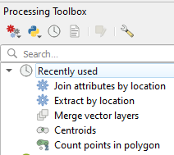
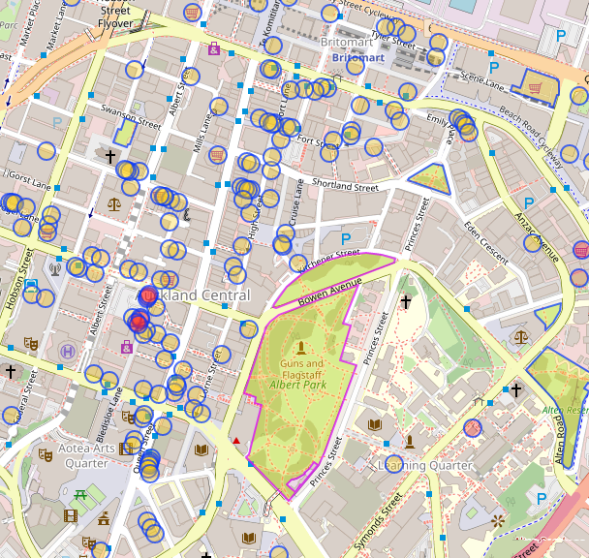
Geospatial Data
Relationship between deprivation and proximity to amenities.
OpenStreetMap - Open-source geographic database of the world.
Translate client’s interests into categories of interest
Scrape geospatial data
QGIS to transform data
~23,000 coordinates
Notes:
In addition to statistical data, we wanted to explore the relationship between deprivation and proximity to amenities.
OpenStreetMap was used here, as we found that this was a first choice for academic research as it is an open source geographic database of the world
here we had to transform clients interests to categories,
then we scraped the geospatial data from openstreetmaps
after that, we used the geospatial modelling software QGIS, this allowed us to do things like calculating centroids for larger locations such as albert park,
counting the number of points per category in a datazone,
and most importantly, since the coordinates and the IMD map wasn’t actually in the same geospatial file format, this tool allows us to manually extract the coordinates and plot them as an overlay on top of the existing map
At the ended of this process we ended up with about 23,000 coordinates of fast food, alcohol, and other locations of interest.
to calculate centroids for some larger locations and also for counting the number of amenities in a datazone.
run some web scraping scripts to

Slide 23
Data in Tableau
Read in as CSVs or geospatial files
Supported operations like pivots, refactors, type conversions
Joined together using the common Datazone column
Notes:
While some pre-processing in R was necessary, Tableau was happy to read the data in as CSV and geospatial files
it had good support for operations like pivots, variable refactors, and type conversions
All of the data sources were joined together within tableau using the common Datazone column created during data preprocessing
That sums up the data side of things, next i’ll be passing the talk over to my partner josh for a deeper look at our complete solution.

Slide 24
03.
OUR SOLUTION

Slide 25
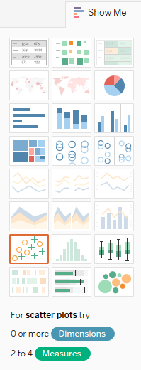
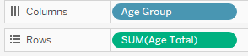
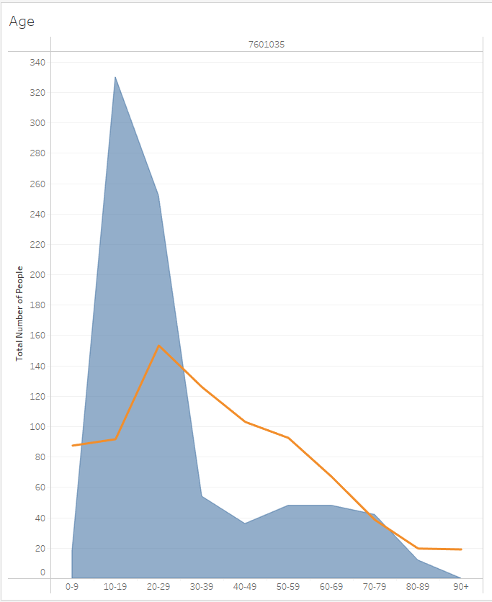
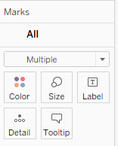
Visualisation in Tableau
Notes:
So ill begin by giving an overview of how to create a visualisation in tableau.
First we assign the variables of interest to the rows or columns of the visualisation. For this example im creating an age distribution so the columns are the age groups and the rows are the counts of people in each age group
From there we can choose from one of the visualisation presets
And customise the different characteristics of the plot marks like the type, colour, size, or tooltip display
And thats it! The default plot options already look pretty good

Slide 26
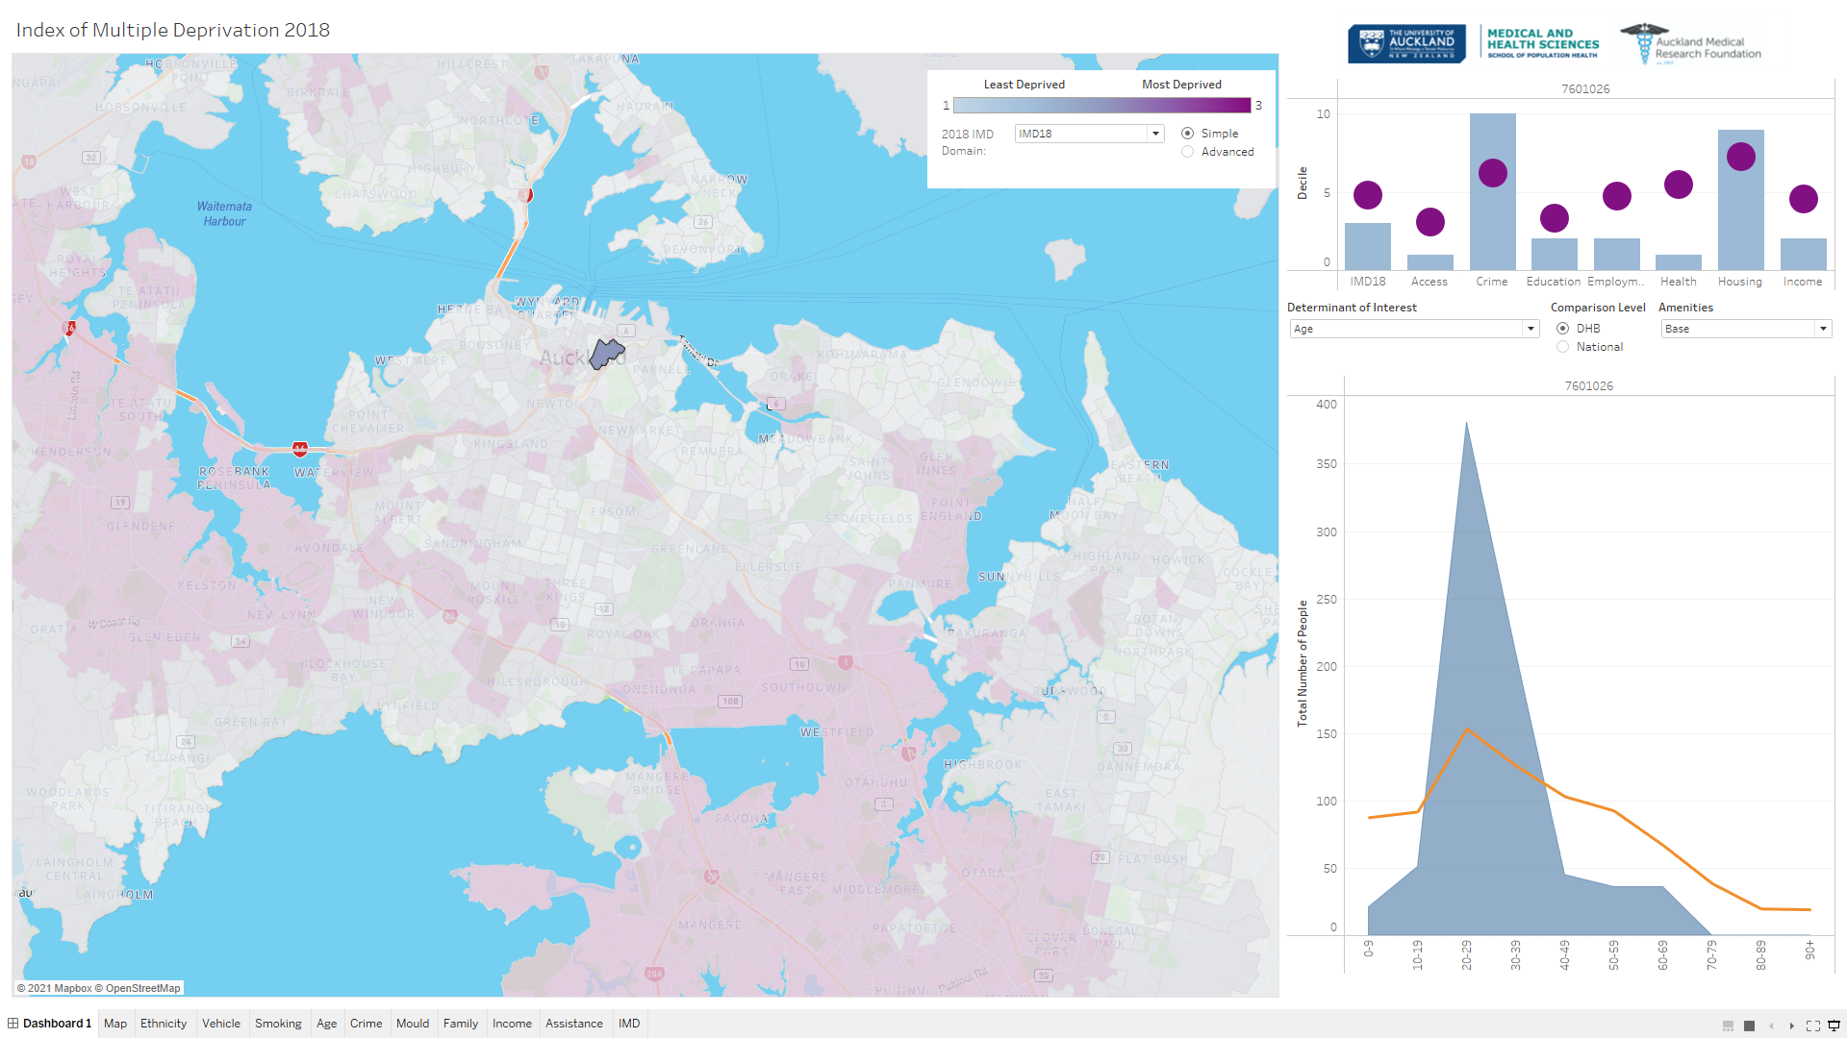
Notes:
So our final result is this tableau dashboard built up of modular components like the one i just demonstrated
Ill go through each of the main components as outlined

Slide 27
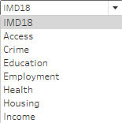
Notes:
The main visual area is a map of new zealand, broken down by datazone. A dropdown allows the user to select which IMD domain they wish to overlay on the map. The colourscale can be a simple Low-medium-high or be set to a decile from 1 to 10

Slide 28
Notes:
The top right hand corner summarises each of the IMD domains for the currently selected datazone, similar to the existing IMD viewer. we have re-used the same colour scheme for familiarity

Slide 29
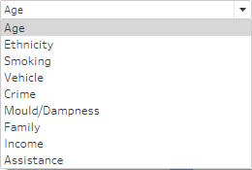
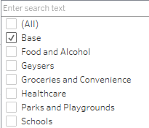
Notes:
The bottom right hand corner is the main area for visualisations and gaining deeper understanding into deprivation. The first dropdown chooses the displayed graph: we have visualisations for age and ethnicity distributions, smoking and crime statistics, vehicle access, housing mould/dampness, family composition, income distribution, and financial assistance
The second dropdown displays points of interest on the map. We have locations for fast food and alcohol stores, geysers, groceries and convenience stores, healthcare facilities, public parks and playgrounds, and schooling.
We also have the ability to choose from comparisons between the selected datazone and the DHB or National average.
Next i have two prerecorded videos demonstrating how our tool is used

Slide 30


Slide 32
04.
CONCLUSION
Notes:
So now moving on to the conclusion

Slide 33

Real World Application
Notes:
Ill begin wrapping up by giving some real world example scenarios of how our work could be used

Slide 34
Notes:
Someone new to an area could visualise crime and housing deprivation and use it to decide where they want to stay

Slide 35
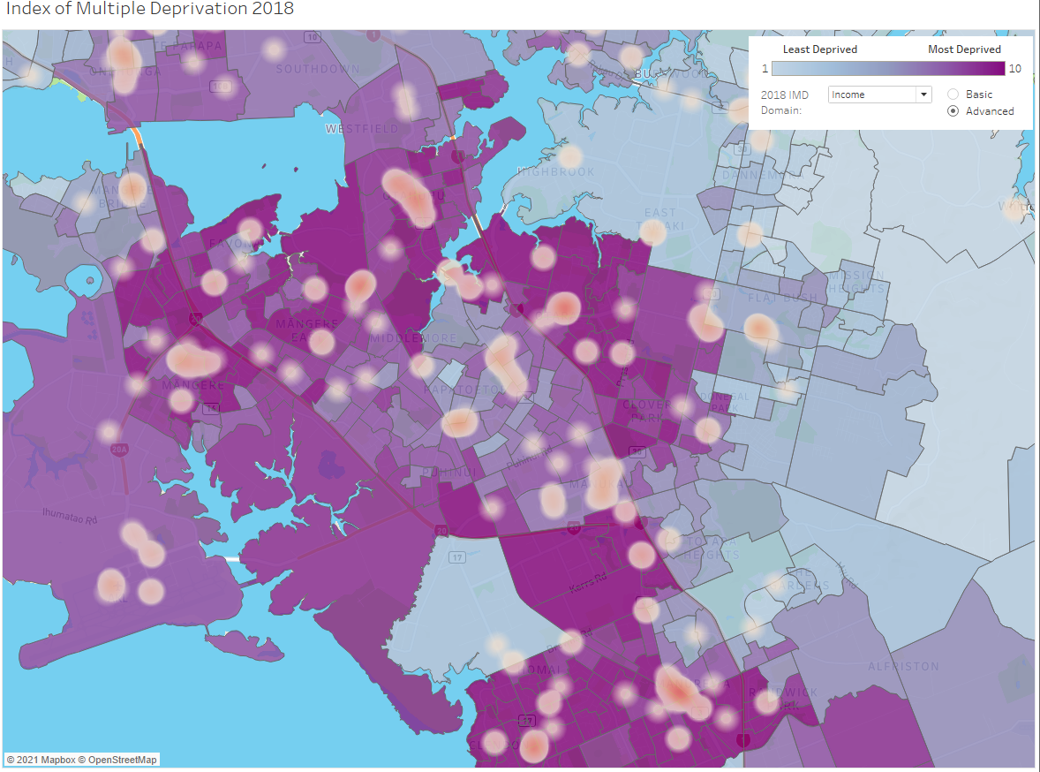
Notes:
A community advocate could visualise all the existing fast food and alcohol outlets in their area to object to the council granting new liquor licenses

Slide 36
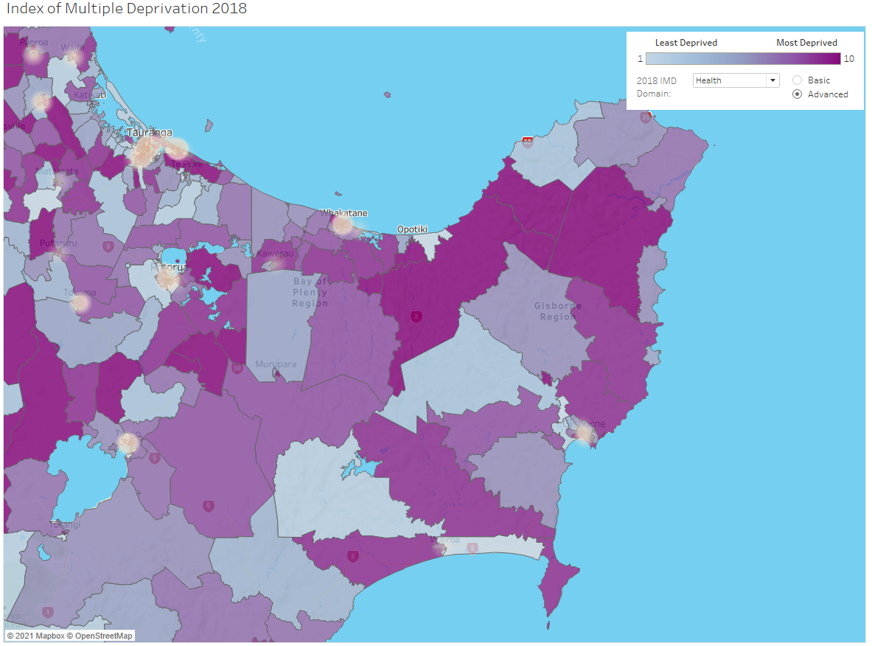
Notes:
A DHB member could visualise the areas deprived in health along with the locations of healthcare facilities and use it target the most vulnerable communities
In each case, it is being aware of and understanding deprivation starts the kind of conversations necessary to make real change

Slide 37
Audience
General Public
Research
Policy
Anyone and everyone
Researchers and Academics
Governmental and Non-governmental agencies
Notes:
So hopefully by now you can see the wide-ranging application of our tool
Being able to be used by those with and without a technical statistical background
Including the general public, researchers and academics, and agencies and policy makers

Slide 38

How Good is Tableau?
Commercial product
Documentation and support
Product ecosystem
Licensing fees
Closed source
Mouse-based graphical interface
User friendly and customisable
Rapid development
Lacks reproducibility of code
Notes:
So how good of a job did we think tableau was able to do?
One thing that sets Tableau apart is that it is a commercial product
That meant it was well documented and with lots of support available online
The tableau product ecosystem also means there is integration with their online sharing and hosting service available as well as a data pre-processing suite
However being a commercial product also means there are license fees and it is all closed source
Tableau is also known for its mouse-based graphical interface
We found this to be user friendly and offered plenty of customisation
Tableau does a lot of the work for you meaning development of visualisations was pretty rapid
However doing everything with a mouse means you do lose out on the reproducibility of code

Slide 39
Future Work
Distribution
Regions
Reporting
More data
Hosting and allowing public access
Select and compare areas and regions
Automatic generation
E.g house prices, court cases
Notes:
In its current state, our tool is ready for distribution. We are currently working with our client to get it securely hosted on the university’s servers
next steps would be around implementing comparisons between larger areas than datazones, generating automatic summary reports, and incorporating more data, for example on new zealand house prices or court cases linked to domestic violence or drug abuse. Some of our current data sources could even be replaced to come natively at the datazone level without the need for downsampling. This would just require IDI access which is currently not possible due to the lockdown.

Slide 40
What did we learn?
Geospatial Data
Tableau
Statistical Consulting
Notes:
Finally, what were the main things cadence and I learn from this project?
We learnt how to deal with geographical and spatial data and how openstreetmaps could be a useful resource for incorporating real world locations and context into a dataset
We got to thoroughly experience tableau as a statistical tool and gained an understanding of what it is capable of
And finally we gained relevant real world experience managing a project and client relationship as statistical consultants

Slide 41
Conclusion
Visualisation tool incorporating new and existing data
Greater insight into the driving factors behind deprivation
Better allocation of resources and services to areas that need it
Notes:
In conclusion we have
Improved on the existing IMD viewer by creating a new visualisation tool incorporating new and existing data
This allows for greater insight into the driving factors behind deprivation, ensuring it can be used by a wide audience from specialists to the general public
And This will enable better allocation of resources and services to the areas and people that need it

Slide 42
Acknowledgements
Special thanks to Dan, Avinesh, Yannan
References:
https://www.inequality.org.nz/understand/
https://imdmap.auckland.ac.nz/download/
https://www.health.govt.nz/our-work/populations/maori-health/tatau-kahukura-maori-health-statistics/nga-mana-hauora-tutohu-health-status-indicators/life-expectancy
https://qv.co.nz/price-index/

Slide 43
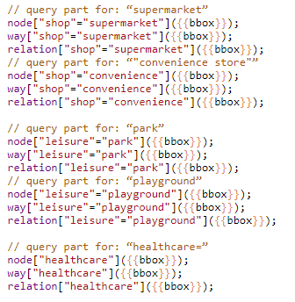
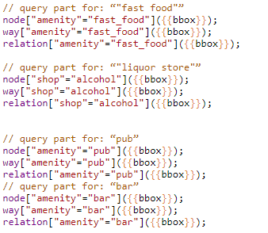
Appendix
1.1 JSON Scripts used to scrape geospatial data

Slide 44
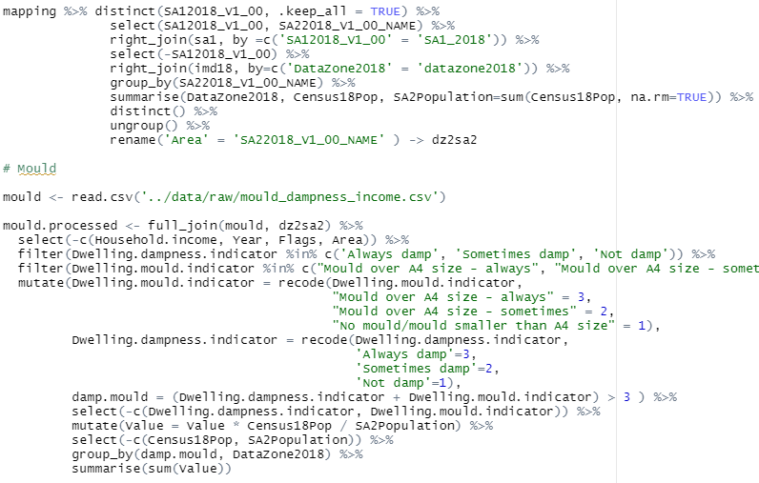
1.2 R code snippets for data processing and Datazone mapping
Notes:
developed by the faculty of medical and health sciences
visualise the relative deprivation between different areas in new zealand
Range of uses from supporting community advocacy to driving resource allocation and policy making

Slide 45
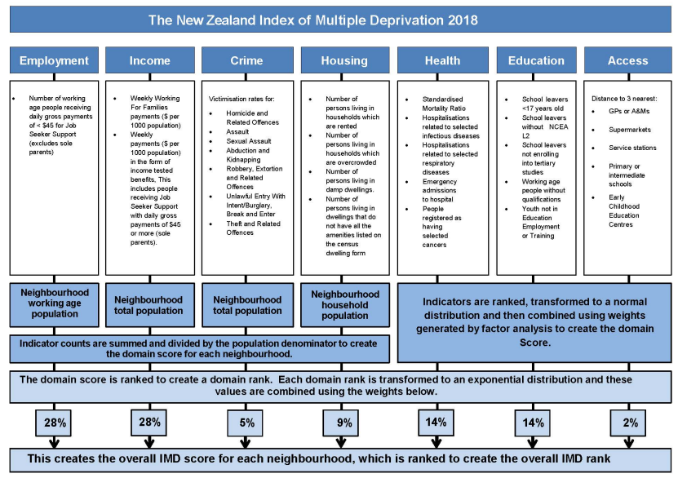
1.3 Detailed description of IMD18 domain ranking factors
Notes:
developed by the faculty of medical and health sciences
visualise the relative deprivation between different areas in new zealand
Range of uses from supporting community advocacy to driving resource allocation and policy making

